Slide 1
GitHub
Fengling Hu
7/9/20

Slide 2
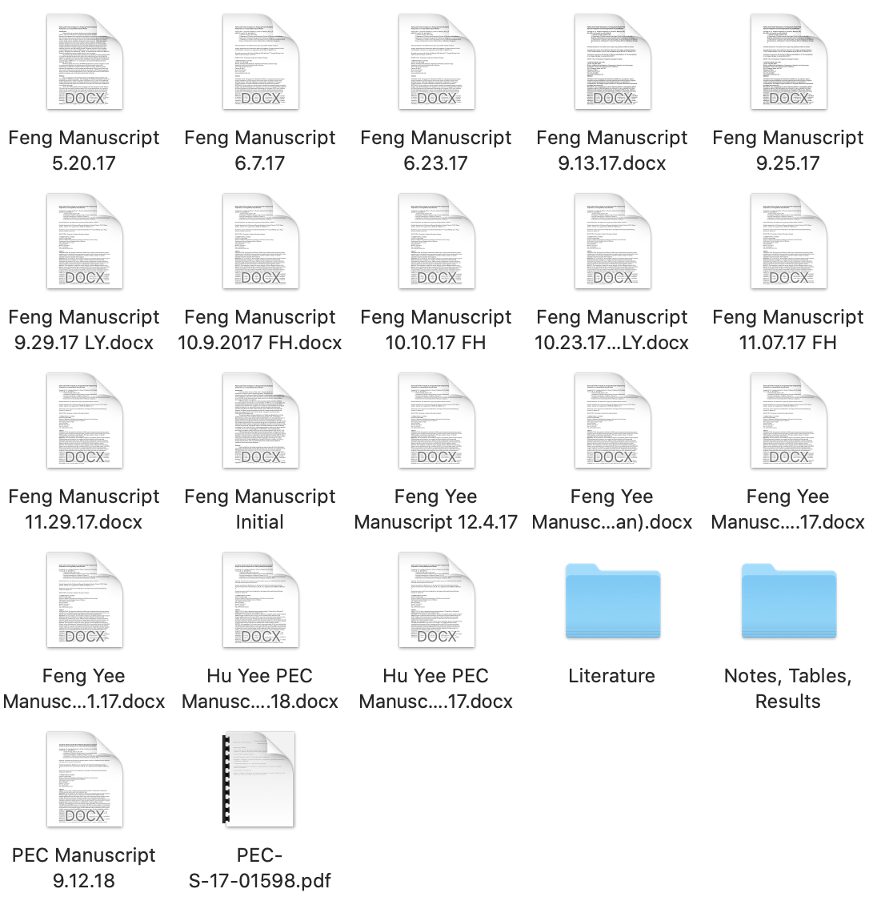

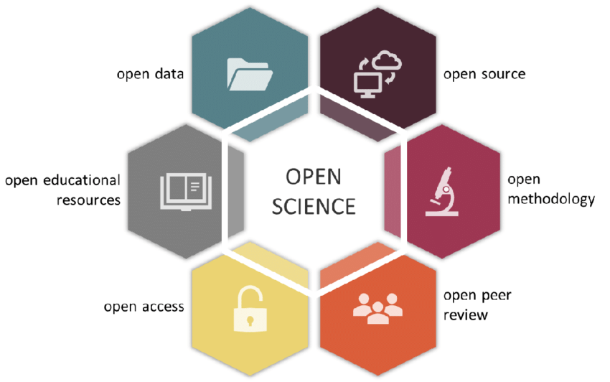

Gallagher, R. et al. The Open Traits Network: Using Open Science principles to accelerate trait-based science across the Tree of Life. (2019). doi:10.32942/osf.io/kac45.

Slide 3
Version Control
Undo
Track changes
Insurance
Collaboration
Storage
Reproducibility
Open code and data
Insurance

Slide 4
Basic Vocabulary
git
GitHub
GitHub Desktop
Repository (repo)
Main/Master
Branch
Origin
Clone
Commit
Push
Pull
Merge

Slide 5
Interacting with Others
Fork
Clone
Pull Request
Issue
https://levelup.gitconnected.com/how-to-sync-forked-repositories-using-git-or-github-2933e497fa16

Slide 6
~~Merge Conflicts~~

Slide 8
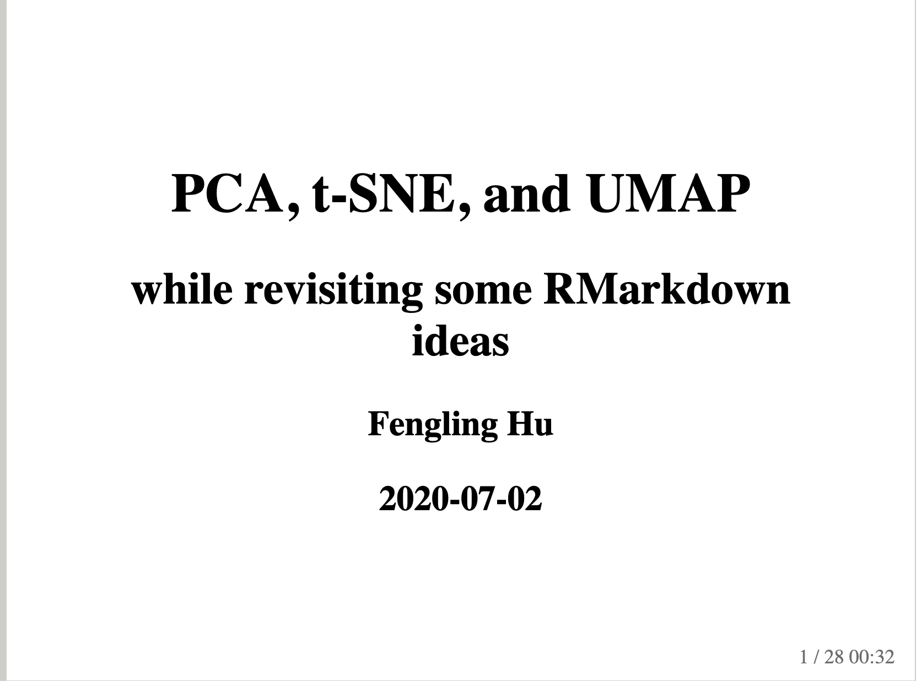
https://github.com/hufengling/hufengling.github.io
https://hufengling.github.io/Visualization/HighDimensionalVisualization#1

